Slide 1

Adama -11/11/18
Outreach to Rural Schools

Slide 2
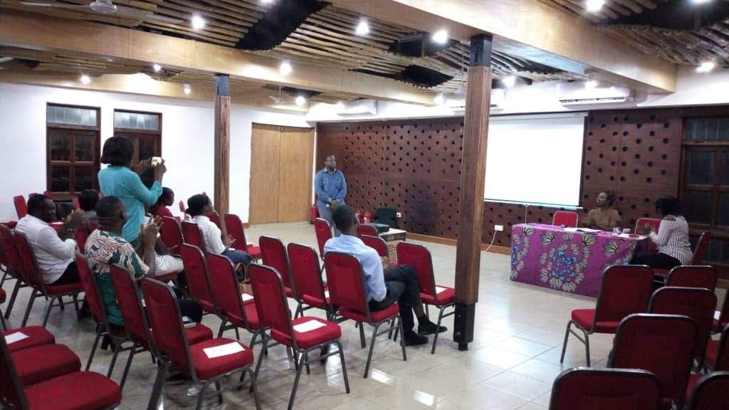
First General Meeting-11/4/19

Slide 3
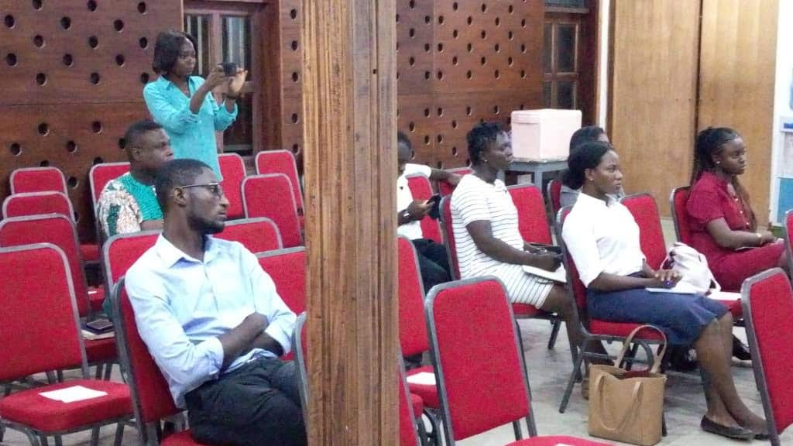
Section of members present

Slide 4
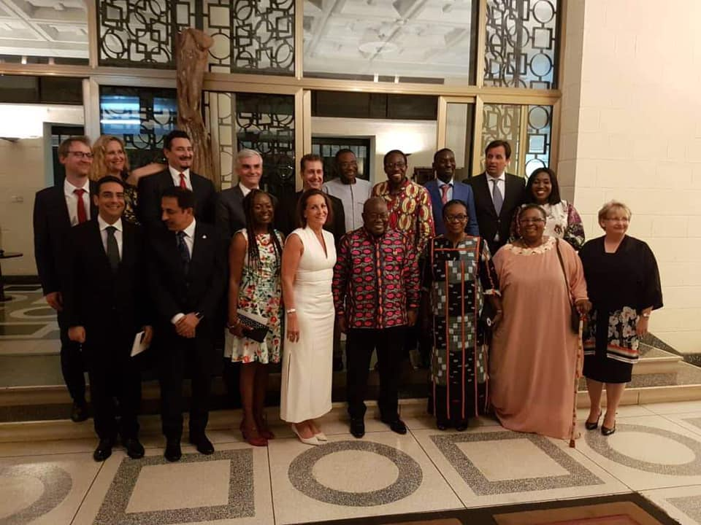
A Reception at the Residence of the Ambassador

Slide 5
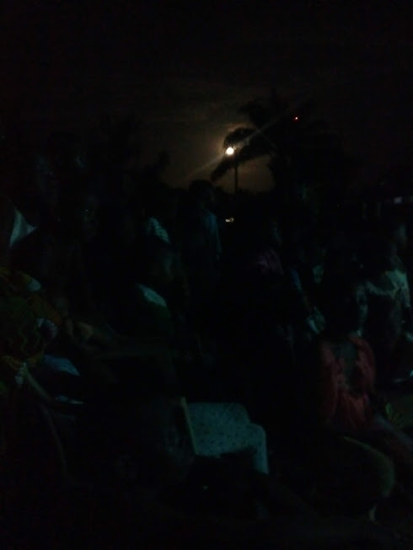
Natriku, March 22, 2019

Slide 6
New Saasabi Basic School, Dodowa
July 5, 2019

Slide 7
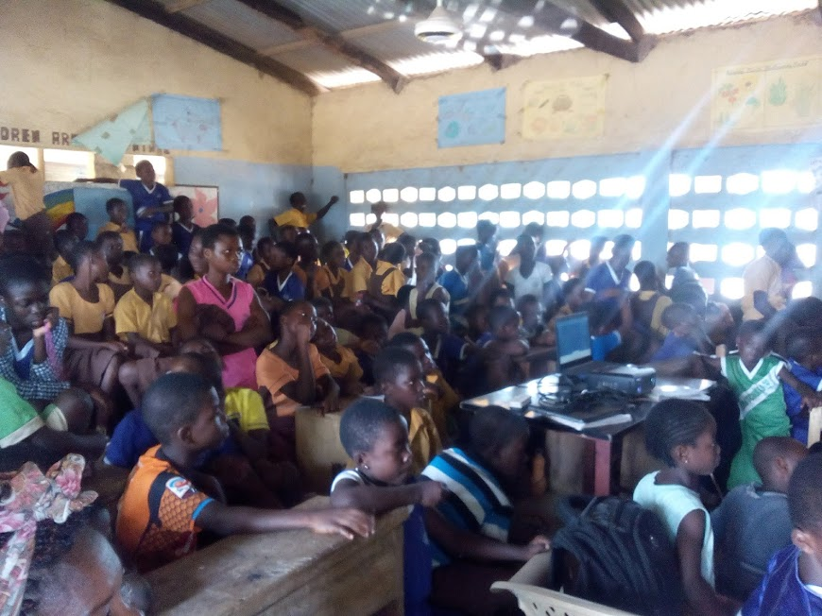

Slide 8
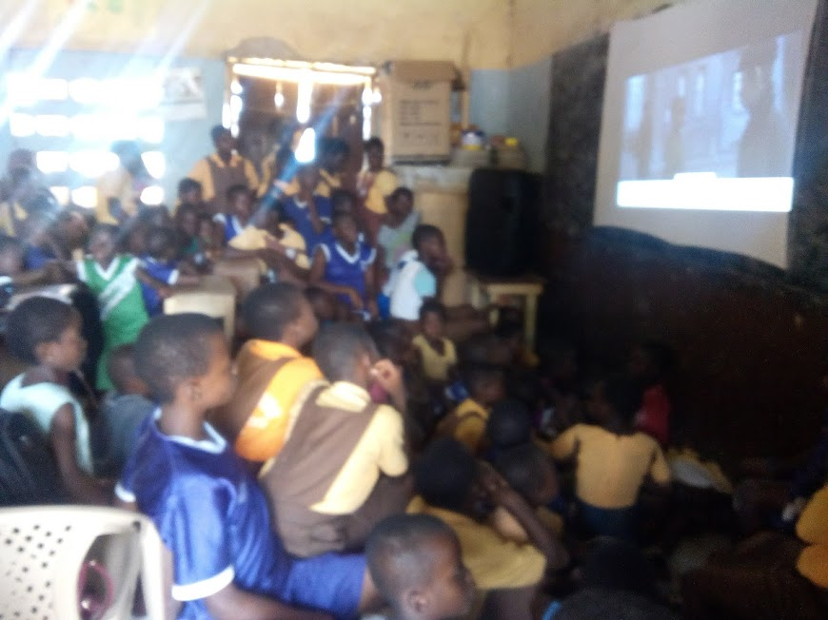

Slide 9
Frafraha Foster Home School
October 25, 2019

Slide 10
